Slide 1

Introduction to JAVA
Object-Oriented Programming

Slide 2
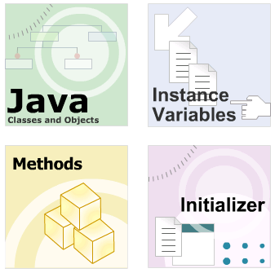
Module Introduction
Basic concept of Object-Oriented Programming (OOP)
Data Member
Constructor
Method

Slide 3
4 main characteristics of OOP
Abstraction
Encapsulation ~ Information hiding
Inheritance
Polymorphism

Slide 4
#1 - Basic concept of OOP
The Genius of Using Objects
The Vocabulary of OOP
Building your first OOP application

Slide 5
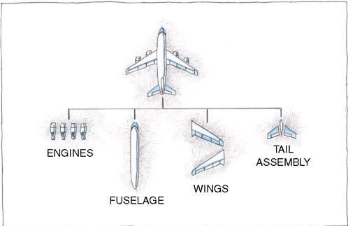
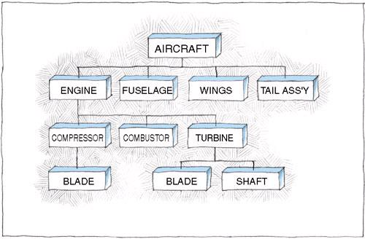
#1 - Object-Oriented Programming

Slide 6



The Genius of Using Objects
How did companies like Dell, Apple, HP… get so big?

Slide 7
How Dell, Apple, Hp… get so big?
They bought components from other companies and assembled the pieces into their products.
Dell didn’t design its own motherboards.
Compaq didn’t engineer its own hard drives or OS.
They bought the pieces and let somebody else do the engineering.

Slide 8
Your program is made of objects
Dell, Compaq and Apple let somebody else reinvent the power supply or the motherboard.
Object-Oriented programming springs from the same idea.
Your program is made of objects.
Each object responsible for carrying out a set of related tasks .

Slide 9
The secret to effective OOP
Each object carries out a small set of related tasks.
If an object needs a task done - but that task isn’t the job of that object - then that object asks another object to do the task.
“If I can’t do it, then I’ll ask somebody who can.”

Slide 10
Never Forget, Please!
Your program is made of objects
Each object carries out a small set of related tasks.
Objects interact by sending message
Since the first object can’t do the task, it asks the second object to carry out the task.
sending message = calling method

Slide 11


The Vocabulary of OOP - Class
The template or blueprint from which objects are actually made.
All code that you write in Java is inside a class.
Classes can be built by extending other classes
When you construct an object from a class, you are said to have created an instance of the class.

Slide 12
The Vocabulary of OOP – Object
An instance of a class.
Each object has behaviors defined by the methods that you can call.
What can you do with this object?
What methods can you apply to it?

Slide 13
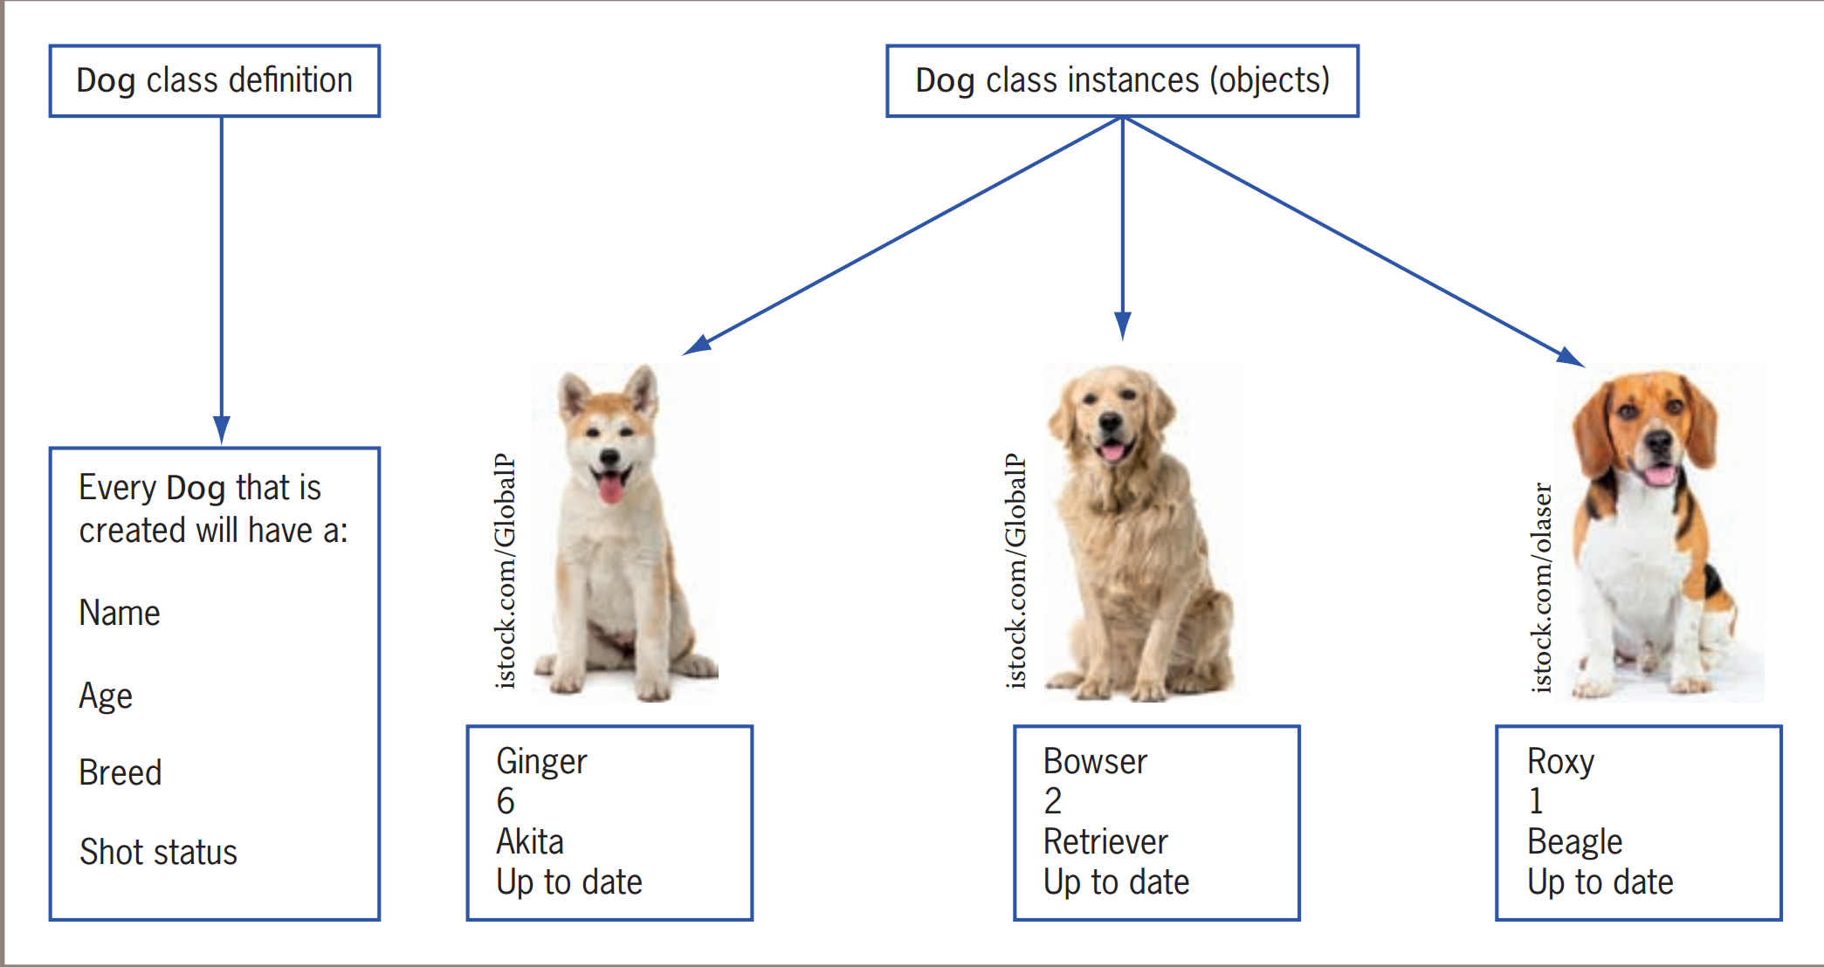
Another example of Class - Object

Slide 14
Tips for newcomer to OOP
When building your application using Java platform, you are said “develop an object-oriented application”
Golden method.
Figure out all objects that made up your application.
With each object, define it.
What Is it?
What can it do? (what does it can do for me?)
What data does it need to know?
Represent each object by class

Slide 15
Defining Your First Java Application
Write a java application to calculate area of a rectangle.
My application made of one objects called Rectangle
What is it?
It represent rectangle object like.
What can it do?
It can calculate its area.
What data does it need to know?
Two data: width and length.
I will create two classes
The class represent Rectangle object.
The class represent the Entry point for application execute.
This second class has a main method that tell JVM where to start.

Slide 16
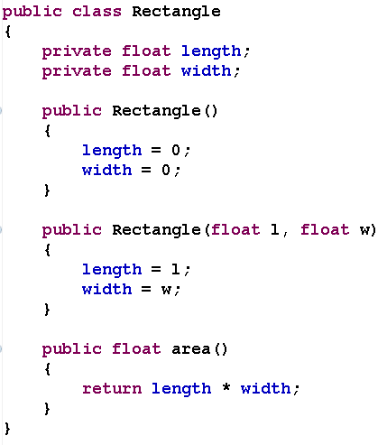
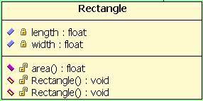
Rectangle class

Slide 17
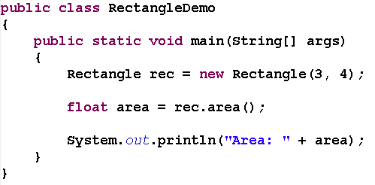

RectangleDemo class (entry point class)

Slide 18
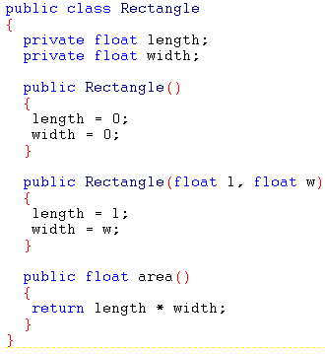
Dissecting the Rectangle class
Name of class
Use Naming rules
Always captain first letter
Use Noun for naming
Data member
What data does it need to know?
Constructor
Define the way to instance object
Same name as the class name
Like function in C but have no return value
Methods
What can it do?
Like function in C
Use Verb for naming
Always lower first letter

Slide 19
Dissecting the Rectangle class
Name of class
Use Naming rules
Always captain first letter
Use Noun for naming
Data member
What data does it need to know?

Slide 20
Dissecting the Rectangle class
Constructor
Define the way to instance object
Same name as the class name
Like function in C but have no return value

Slide 21
Dissecting the Rectangle class
Methods
What can it do?
Like function in C
Use Verb for naming
Always lower first letter

Slide 22
Dissecting the RectangleDemo class
In order to execute, Java application (program) must have a class that defines a method called main.
The main() method in the public class is invoked by the JVM to start the application.

Slide 23
Creating objects (instance object)
An object must be created before using in a program.
Declare a variable to store the object reference.
Objects can only be manipulated via references
Creating an object.
Using the new operator in conjunction with a call to a constructor

Slide 24
Invoking Methods
Using the '.' operator
Syntax:
<the object reference> ‘.’ <the method to be invoked>

Slide 25
The use of the dot ‘.’ notation
Invoke method
Access data member
Govern by the accessibility of the member

Slide 26
Dissecting the Rectangle class

Slide 27
#2 – Data Member
Instance Variables
Class Variables
Access modifier

Slide 28
Instance variables
The values of those variables define the state of object.
All instances of a class have the same instance variables
May have different values inside them.
Has an “access modifier” associated with it.

Slide 29

Example of Instance variables
recA
length = 3.0
width = 4.0
recB
length = 6.4
width = 4.7

Slide 30
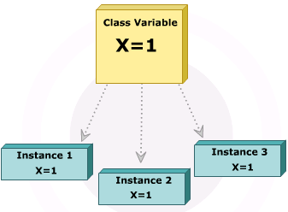
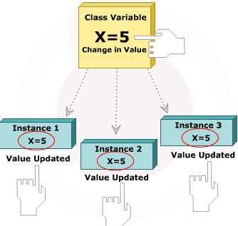
Class Variables (Static Variables)
Variable that is accessed without using an object of a class.
Declare using the static keyword.
Only one copy of a static variable is shared by all the objects of the class.
Change in the value of static variable is reflected by all the objects of the class.

Slide 31
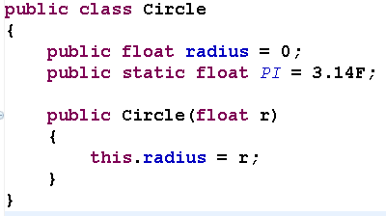
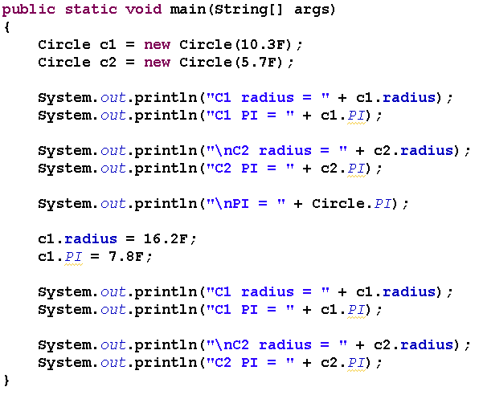
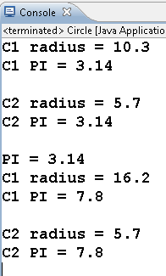
Example of Static Variables

Slide 32
#3 - Constructor
Constructor

Slide 33
Constructor - how to instance an object?
Same name as the class.
A class can have more than one constructor.
A constructor can take zero, one, or more parameters.
Has no return value.
Always called with the new operator.
Use for initializing variables and invoking any methods that may be for initialization.
If a class does not have an explicit constructor, a default constructor (no-argument) is provided.

Slide 34
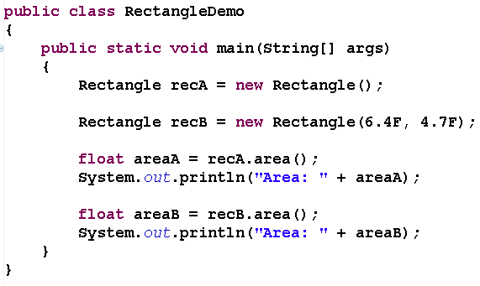

Example of Using Constructor

Slide 35
#4 - Methods
Instance Method
Class (Static) Methods
Variable Argument Methods
Calling method and Passing Arguments by Value.
Calling method and Passing Arguments by Reference.

Slide 36
Instance Method
A function defined in a class
Define the behaviors of an object
What can you do with this object?
What methods can you apply to it?
Provide a mechanism for accessing the private data stored in an object

Slide 37
Static Methods
Methods that do not operate on objects.
Can be called without creating any objects of the class.
Call static method, supply the name of the class.
Declared using the static keyword.
Can directly refer only to static variables and other static methods of the class.
Cannot refer to non-static methods and variables

Slide 38
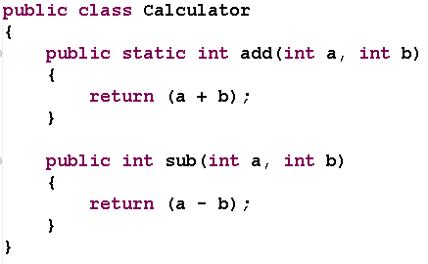

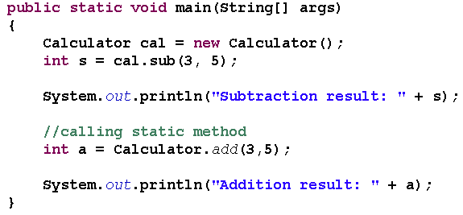
Example of Static Methods

Slide 39
static methods usage
When a method doesn't need to access the object state
When a method only needs to access static fields (variable) of the class.

Slide 40

Questions?
Can static methods access instance variables?→NO
Can instance method access static variable? → YES
Why the main method of Java entry class must declare static?

Slide 41
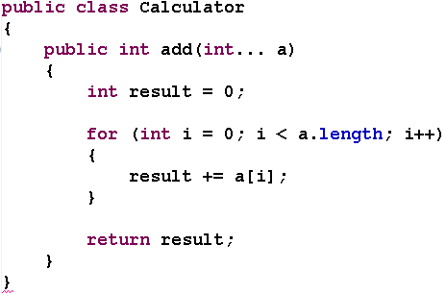

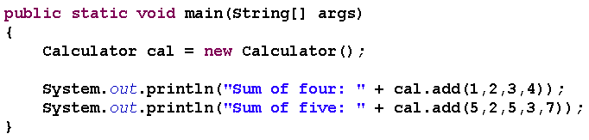
Variable Argument Methods
Allow calling a method with variable number of arguments.

Slide 42
Calling method and Passing Arguments by Value.
Value from calling method is passed as an argument to the called method.
Any change made to that passed value in the called method will not modify the value in the calling method.
Variables of primitive types (int, float ..) are passed by value.

Slide 43
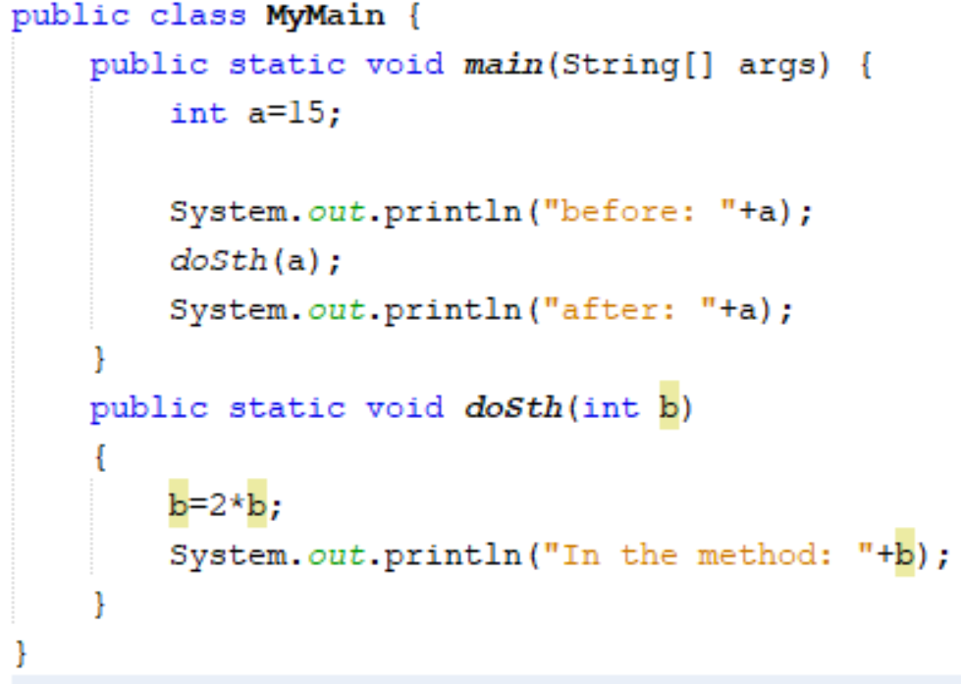
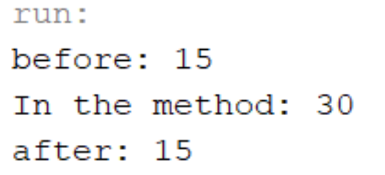
Example of Calling method and Passing Arguments by Value.

Slide 44
Calling method and Passing Arguments by Reference.
Called method to change the value of the parameter passed to it from the calling method.
When references are passed as parameters, the caller can change the values stored but not the reference variables.

Slide 45
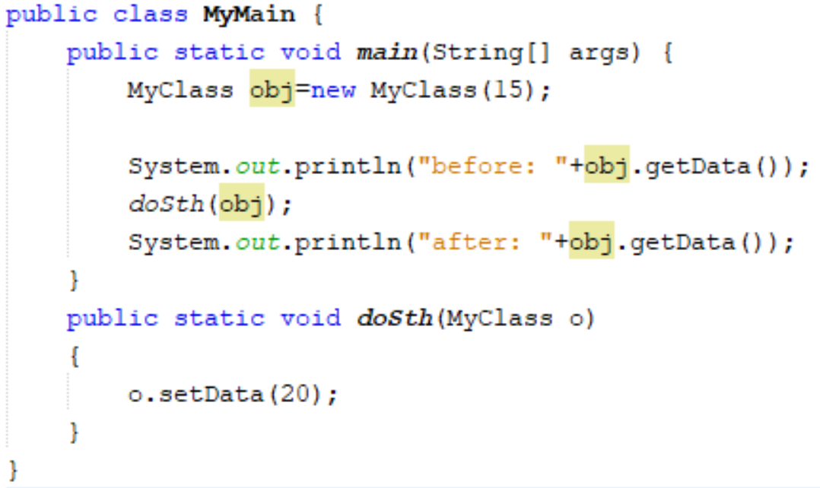
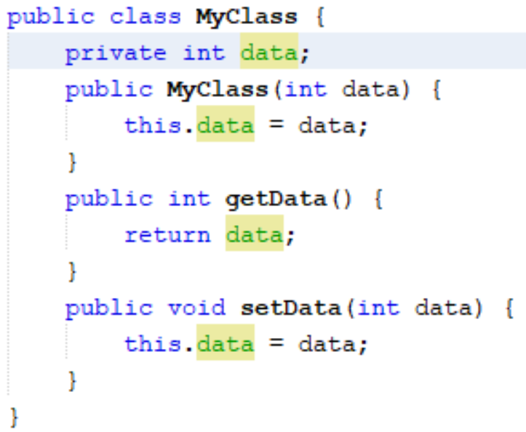
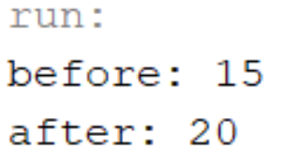
Example of Calling method and Passing Arguments by Reference

Slide 46
Access modifier
Indicate the level of access permitted to object’s data members and object’s methods
public:
Available to any other class anywhere
protected
Accessible only to subclasses of that class, and nowhere else
No name (default)
Accessible to all objects within the same package, but inaccessible to objects outside the package.
private
Accessible only from within the class in which they're declared

Slide 47
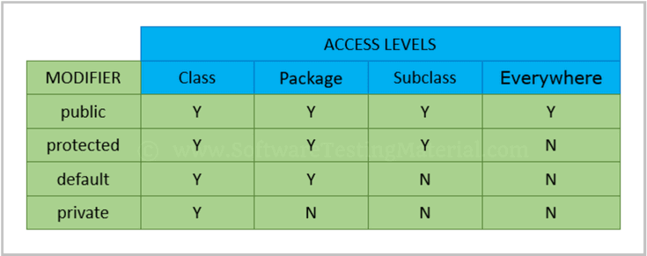
Access modifier

Slide 48
That’s about all for today!
Your program is made of objects
Objects interact by sending message
Class
Data Member
Constructor
Method
Object
Instance object
Call method
Thank you all for your attention and patient !

Slide 49
An example
Create a Java program that help us to work with fraction number.
A class Fraction
Have numerator and denominator
Can: display, simplify, inverse
A class FractionOperator
Can do operation with Fraction object
(+,-,*,/)
A class FractionDemo
Main class.

